Slide 1
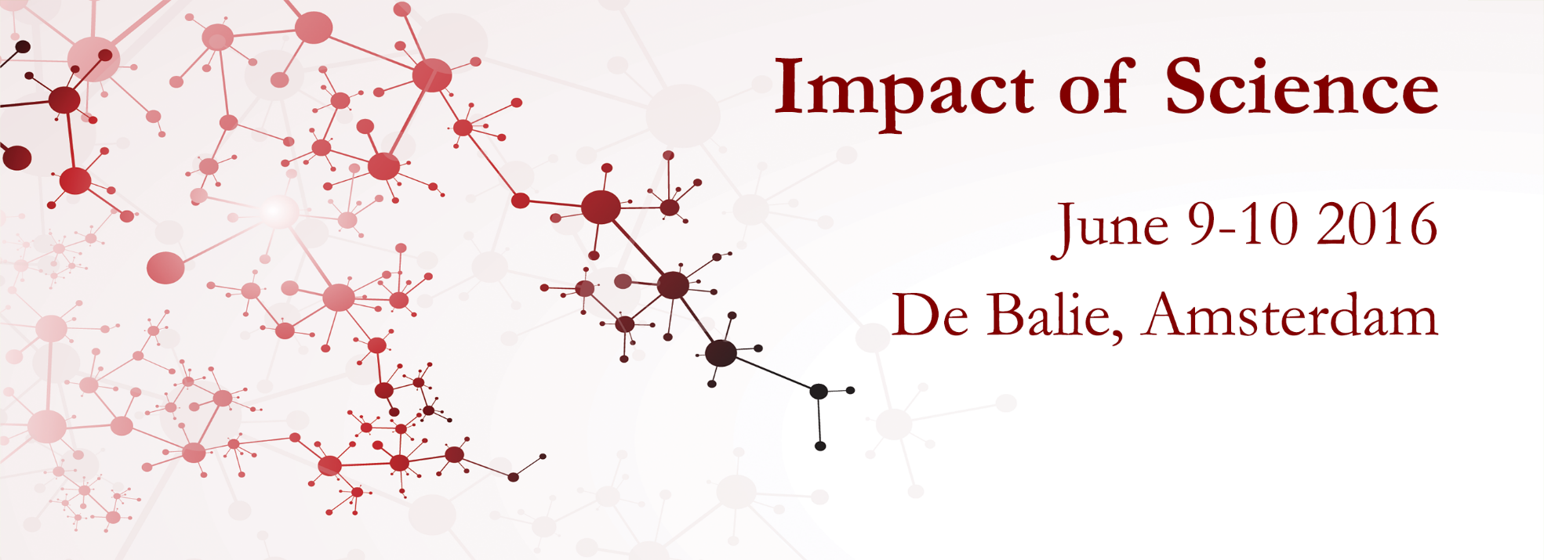
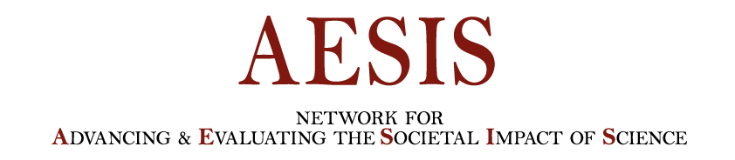
Impact of Social Sciences, Humanities and Arts Conference
The Roundtable Session on:
Open Science & Impact
15 October, 2021

Slide 2
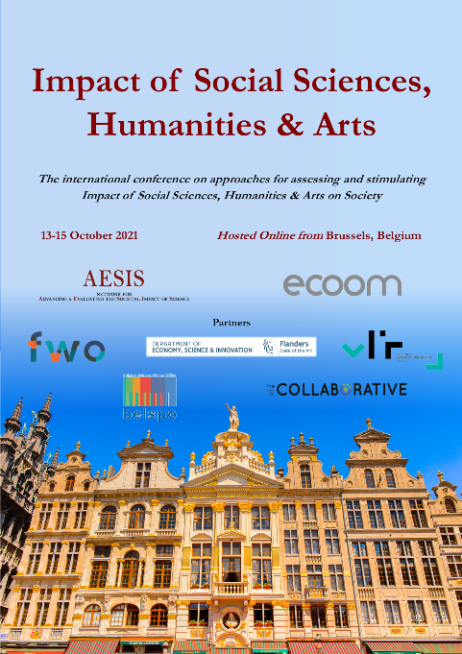
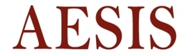
Impact of Social Sciences, Humanities and Arts
13-15 October, 2021
Johan Rooryck Leiden University Professor and Open Access Champion for cOAlition S, The Netherlands
Bart Fransen: Coordinator Centre for the Study of the Flemish Primitives, Koninklijk Instituut voor het Kunstpatrimonium (KIK), Brussels, Belgium
Overview of the Coordinators
#SSHA21

Slide 3
Impact of Social Sciences, Humanities and Arts
13-15 October, 2021
Bart Fransen
Coordinator Centre for the Study of the Flemish Primitives, Koninklijk Instituut voor het Kunstpatrimonium (KIK), Brussels, Belgium
#SSHA21

Slide 4
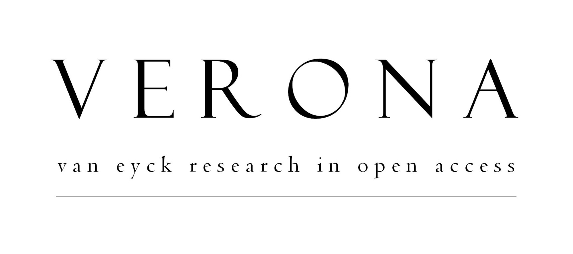



Slide 5
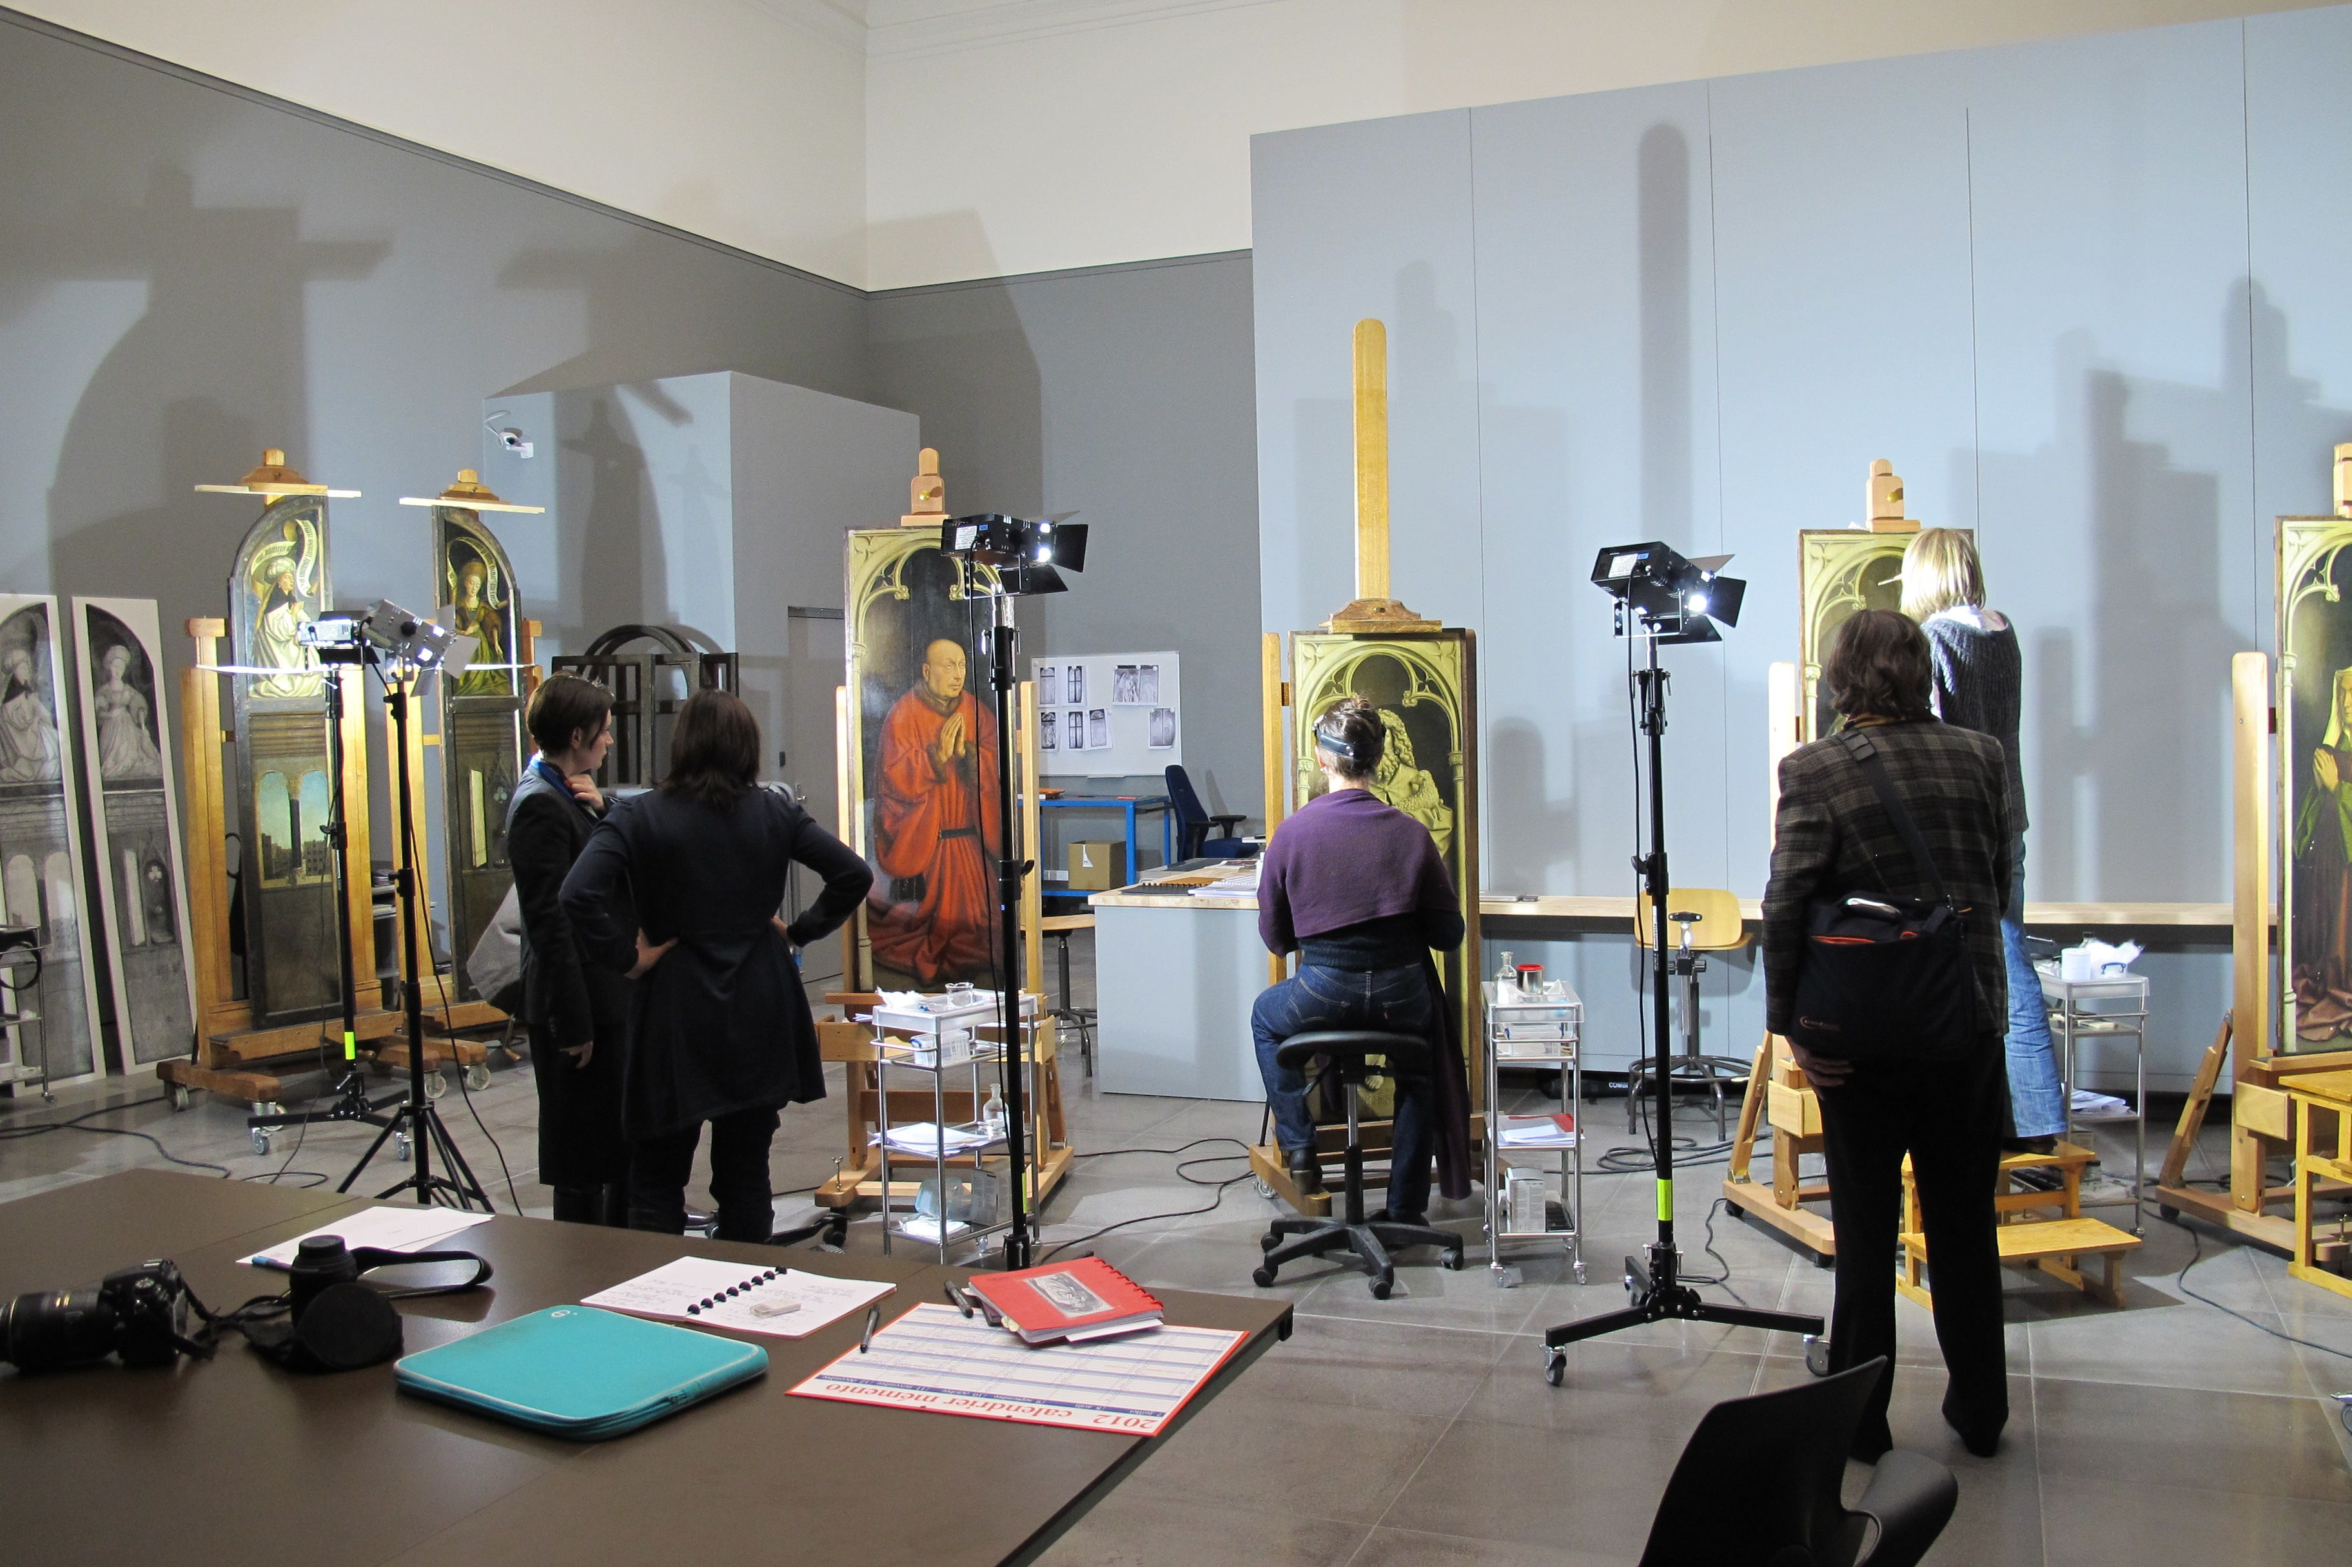
GOALS OF THE PROJECT
new research on Jan van Eyck that contributes to art-historical questions raised by the Ghent Altarpiece, currently in restoration
examination of all paintings by Jan van Eyck and his workshop using standardised technical procedures
to make all imagery available in open access on the website Closer to Van Eyck, as a point of reference for comparative research in the Van Eyck group

Slide 6
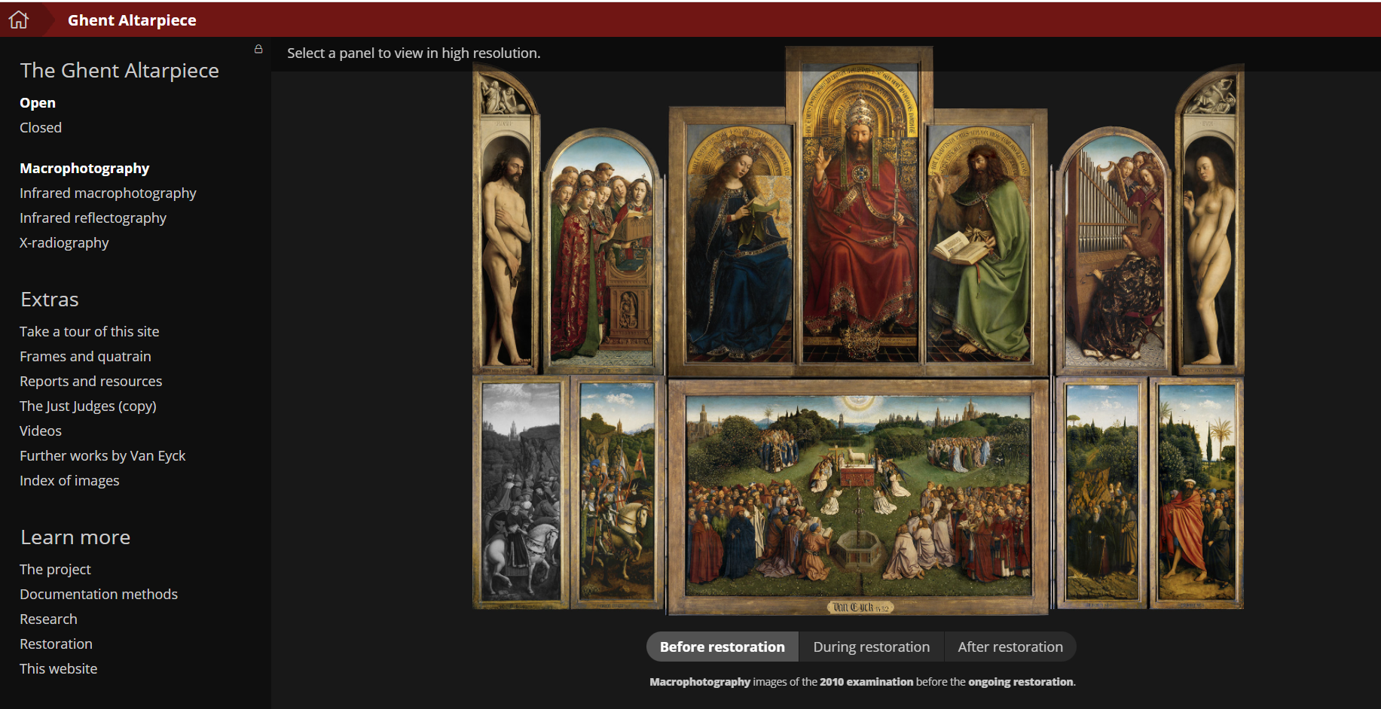

Slide 7
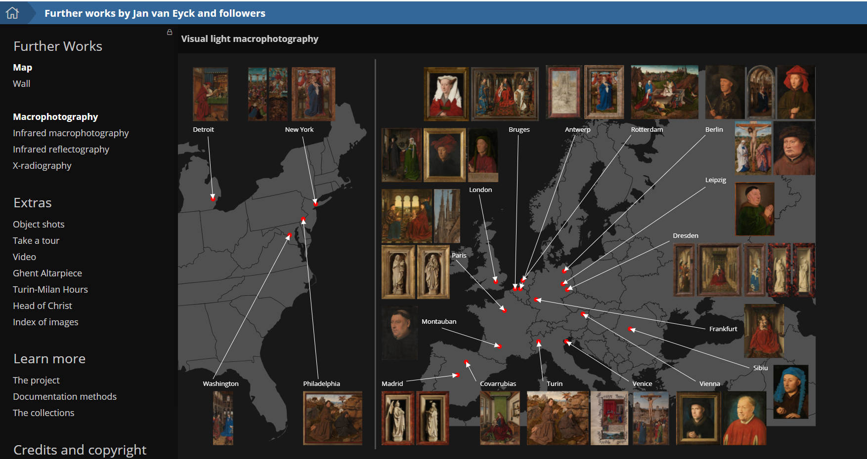

Slide 8
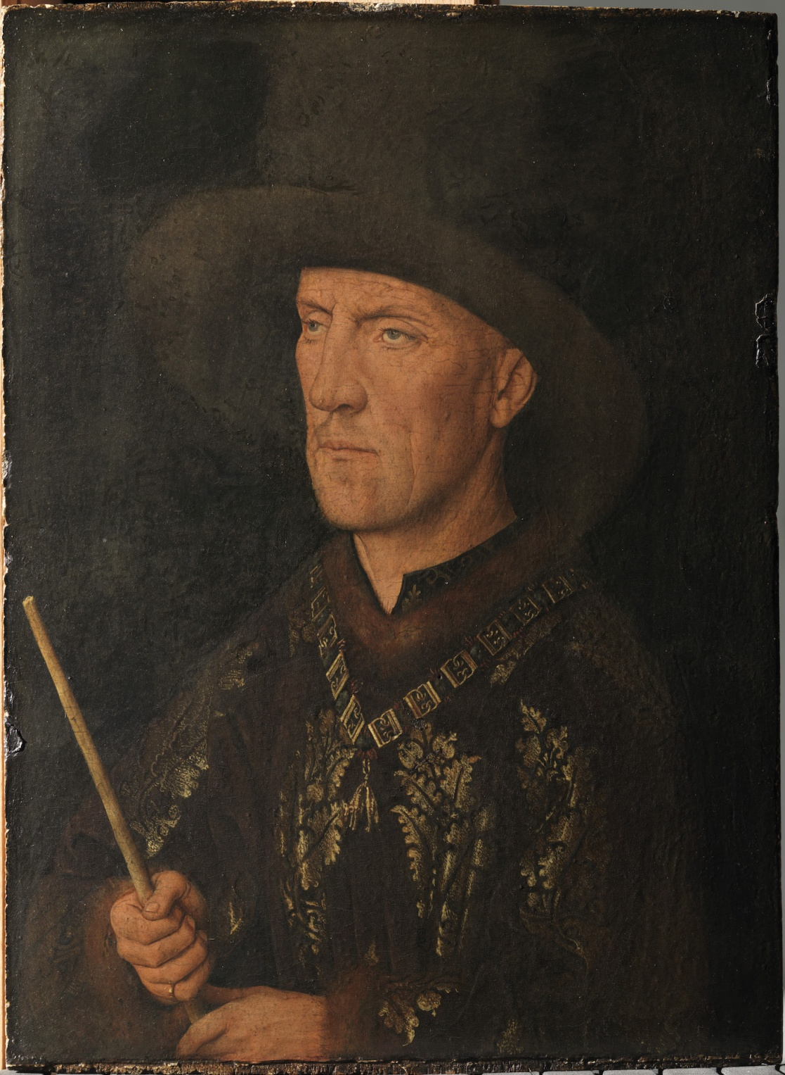
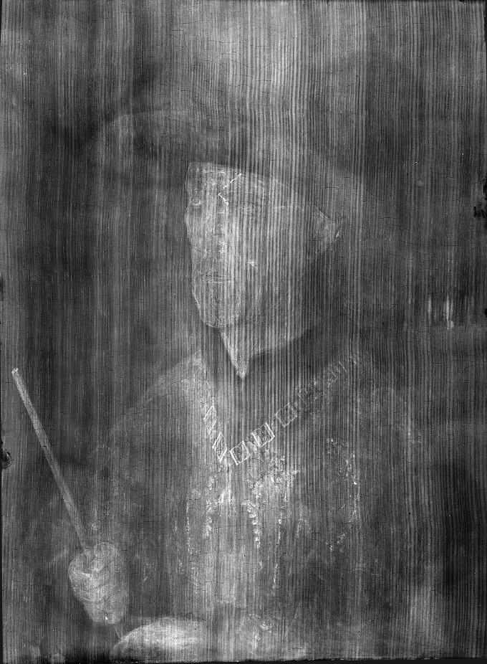
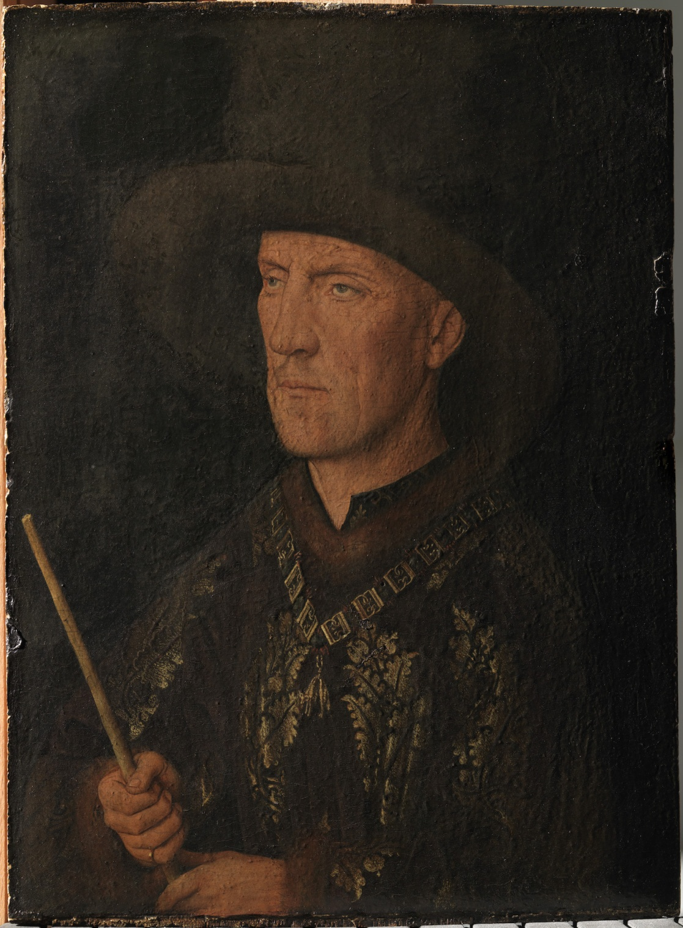
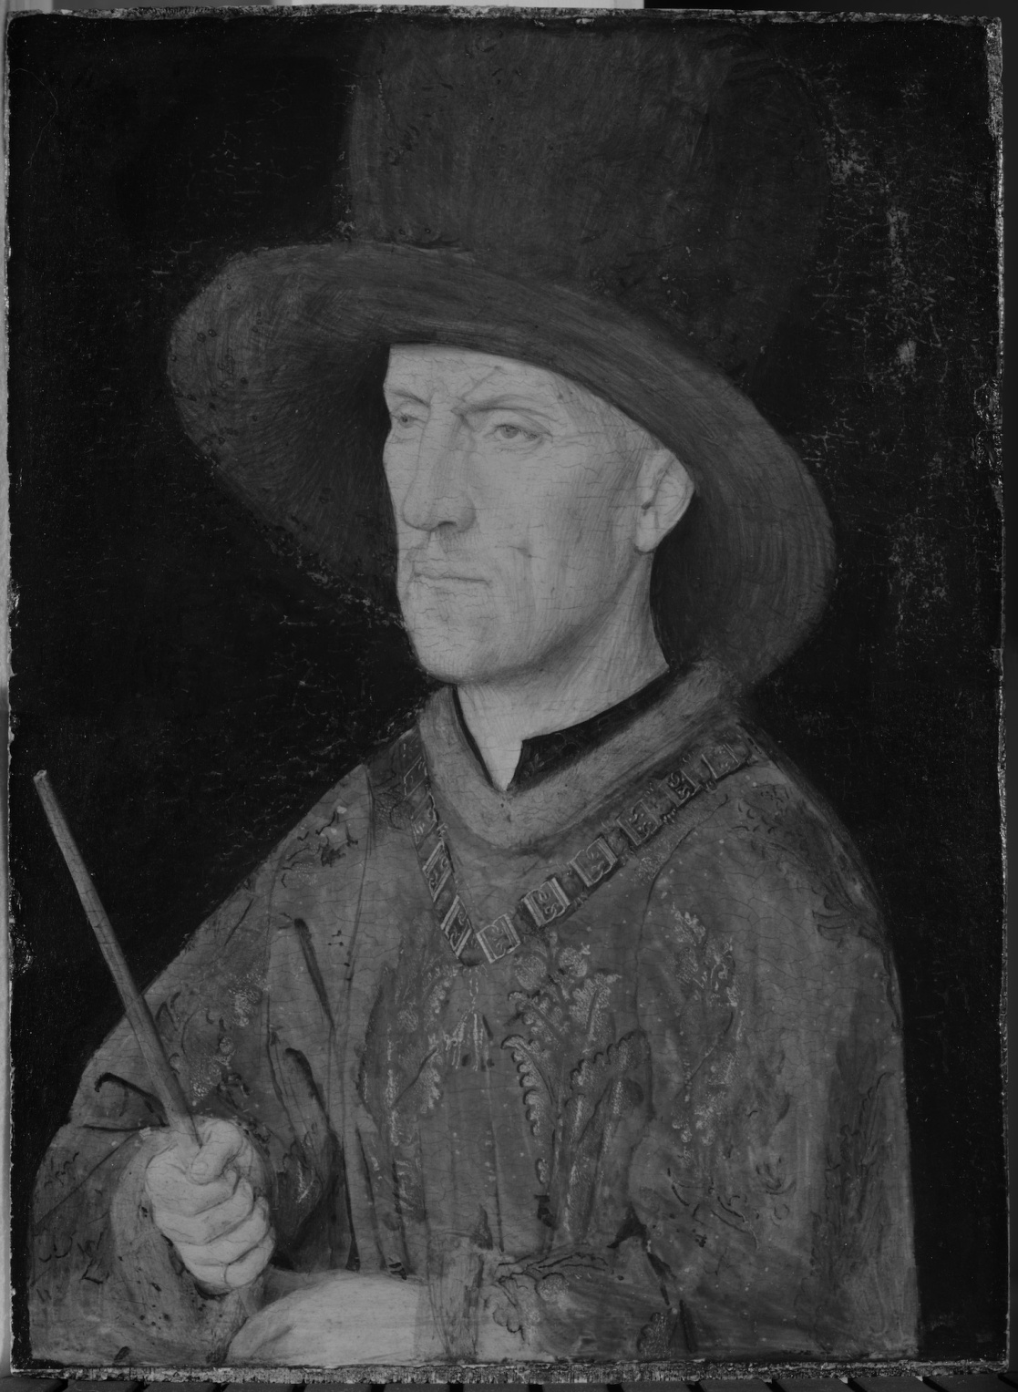
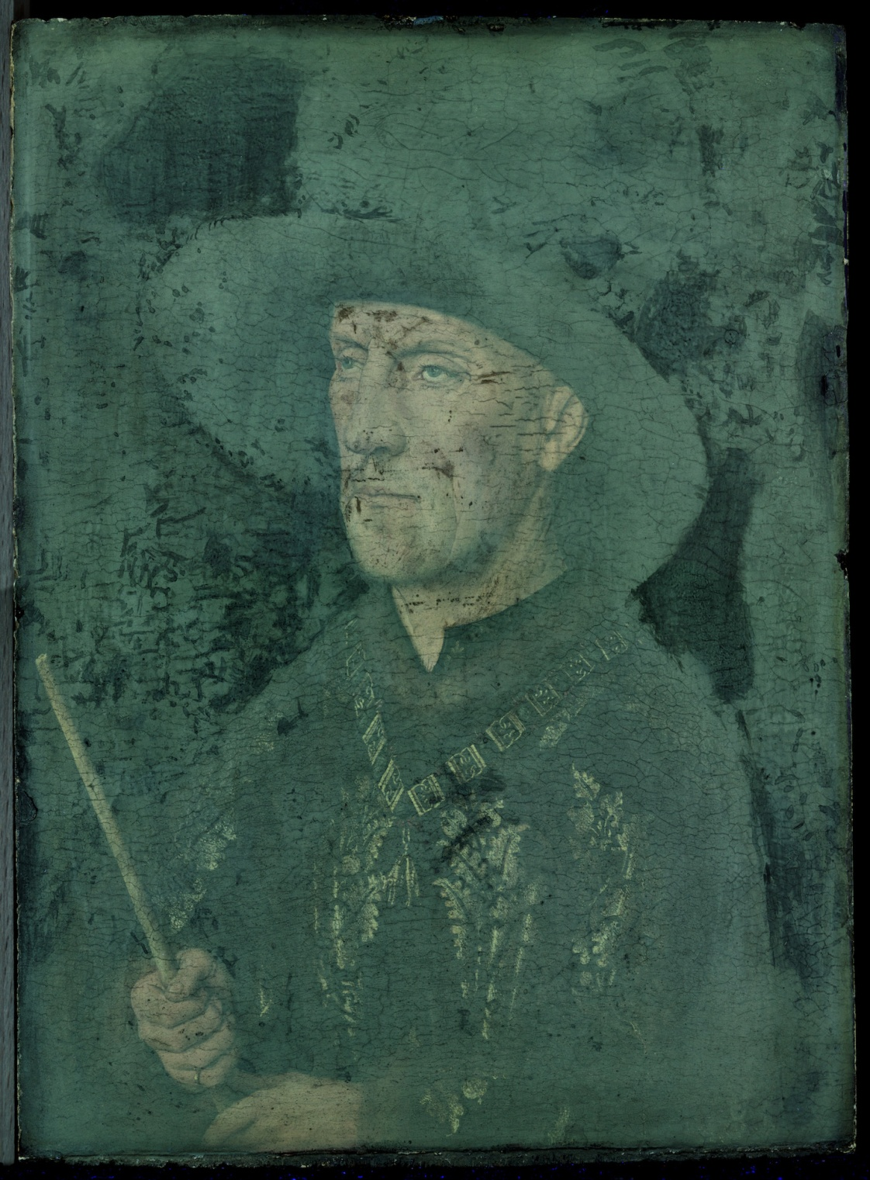
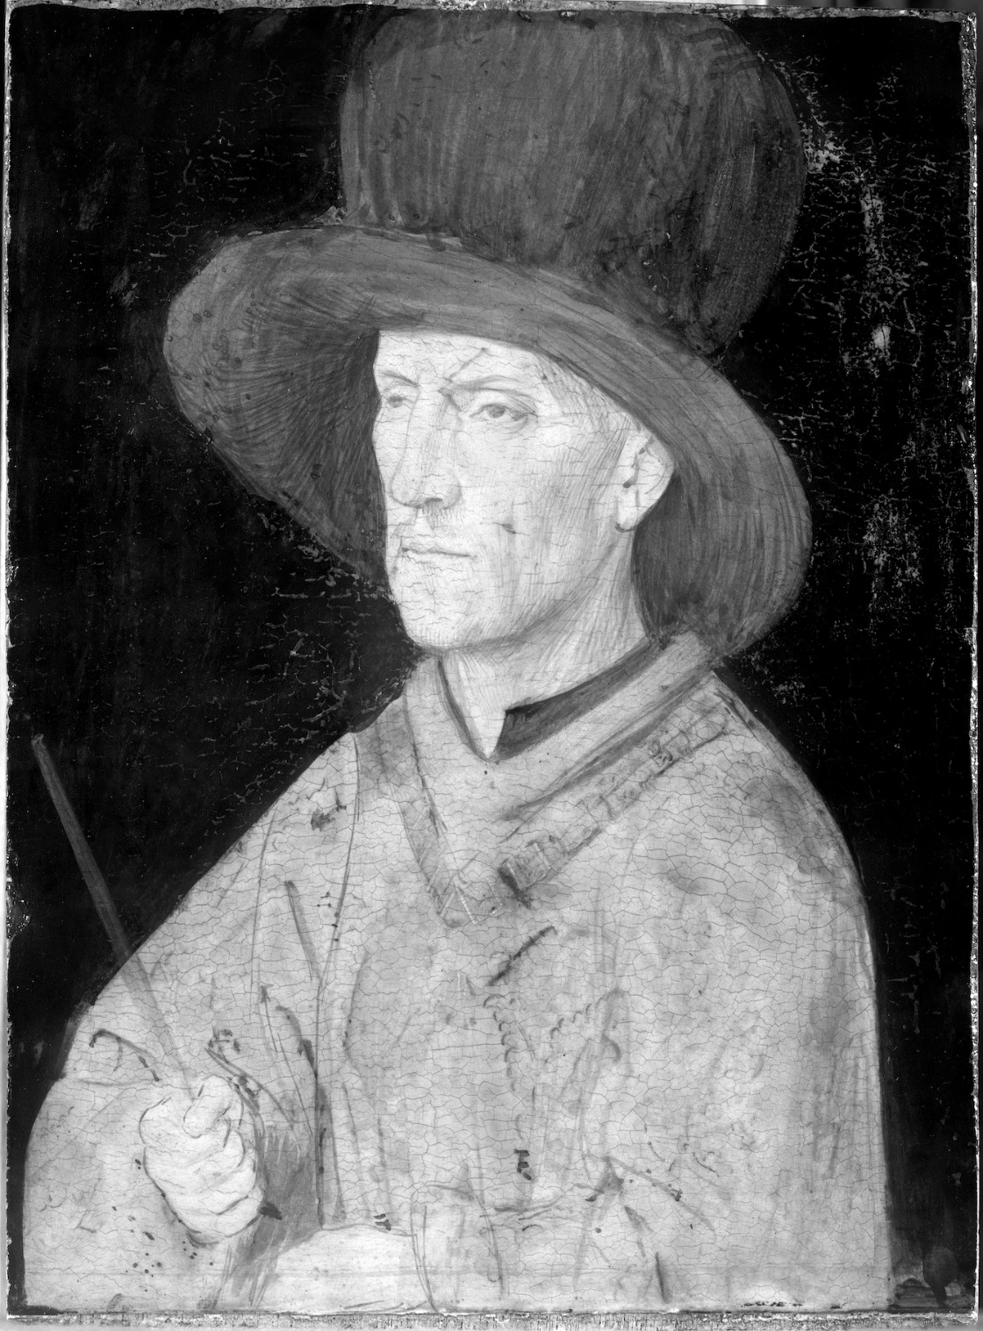
normal
raking
infrared
IRR
UV fluorescence
X-Ray
Baudouin de Lannoy (26 x 20 cm) in all modes: 15 x 20 cm (2 images per mode)

Slide 9
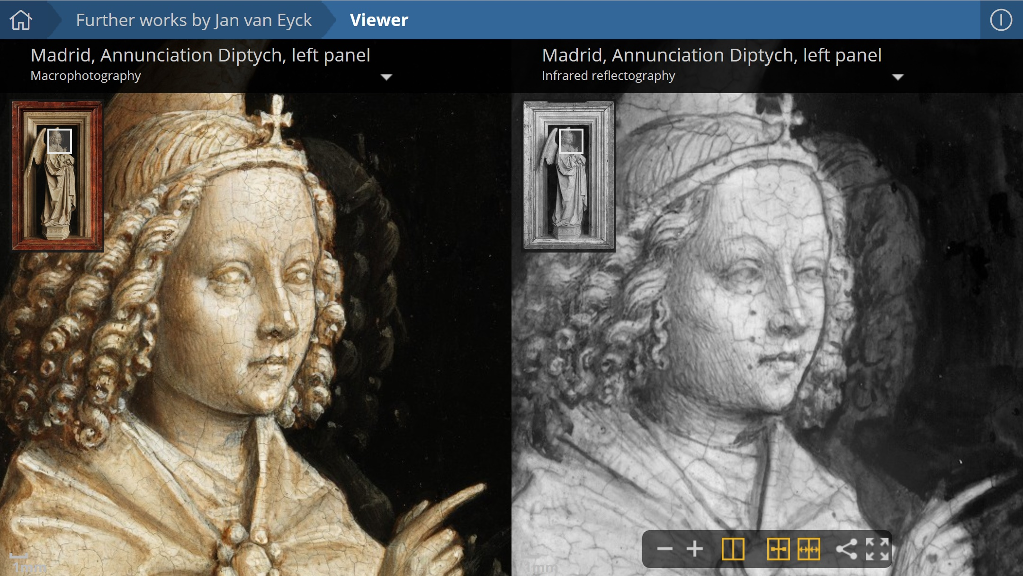

Slide 10
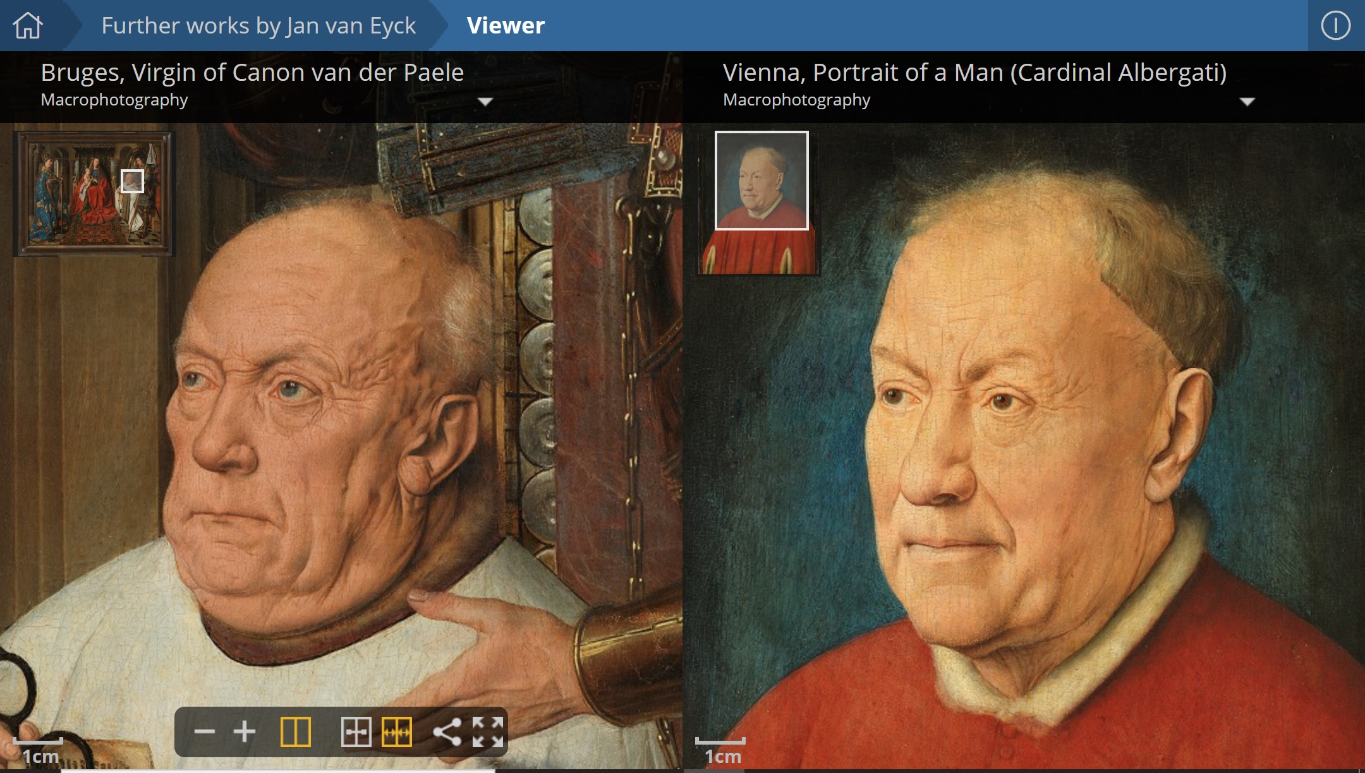

Slide 11
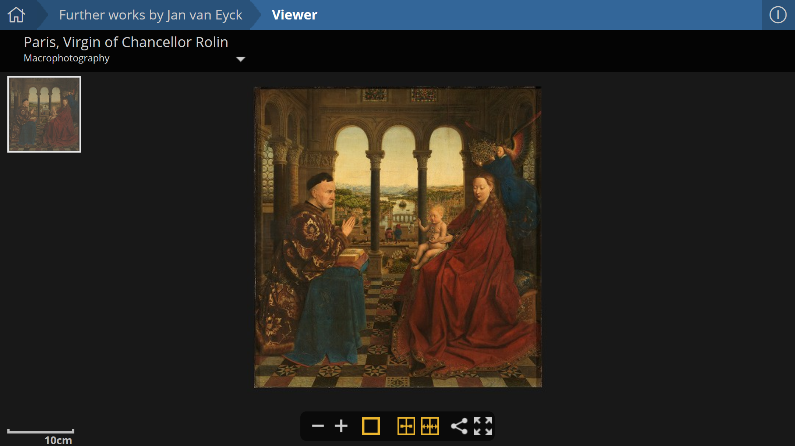

Slide 12
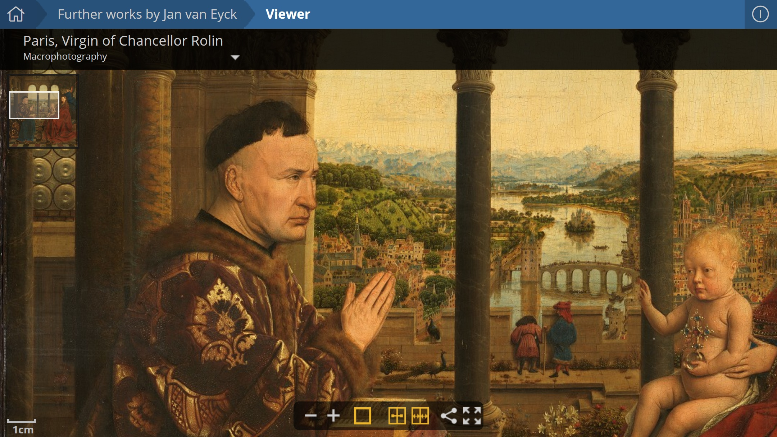

Slide 13
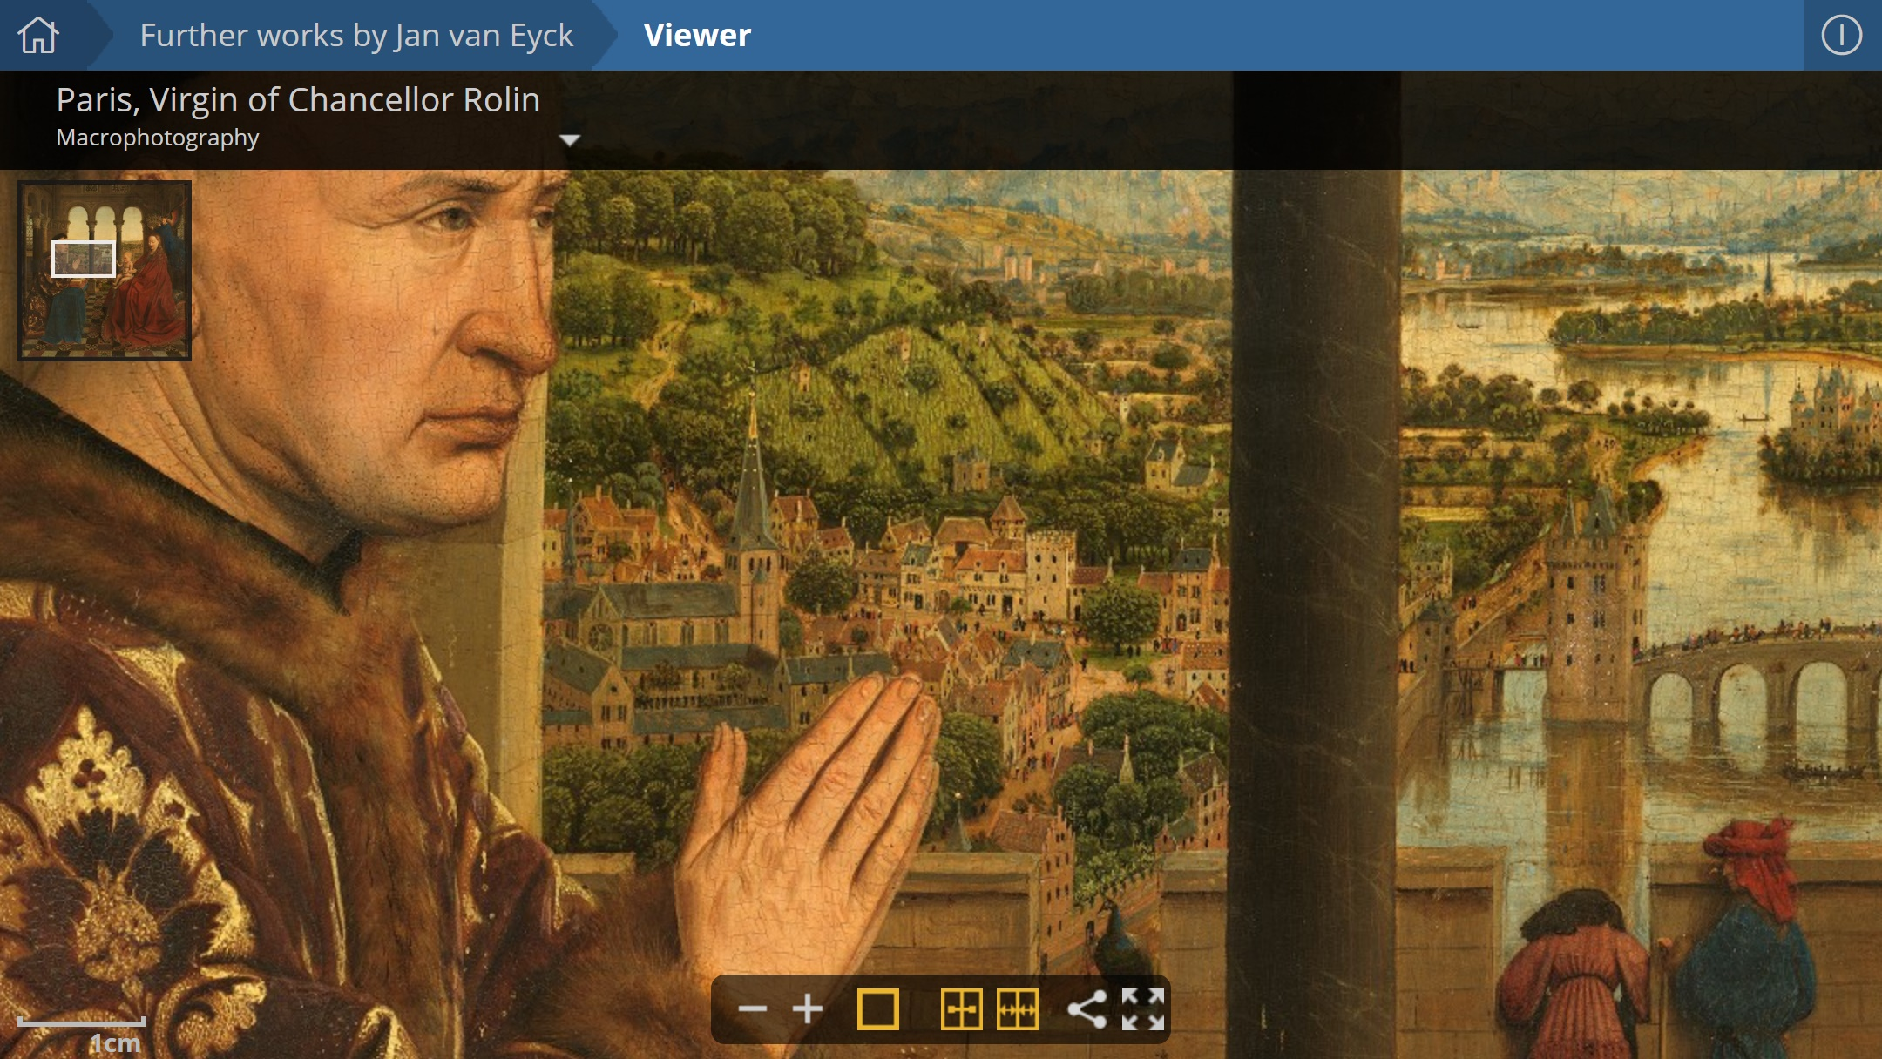

Slide 14
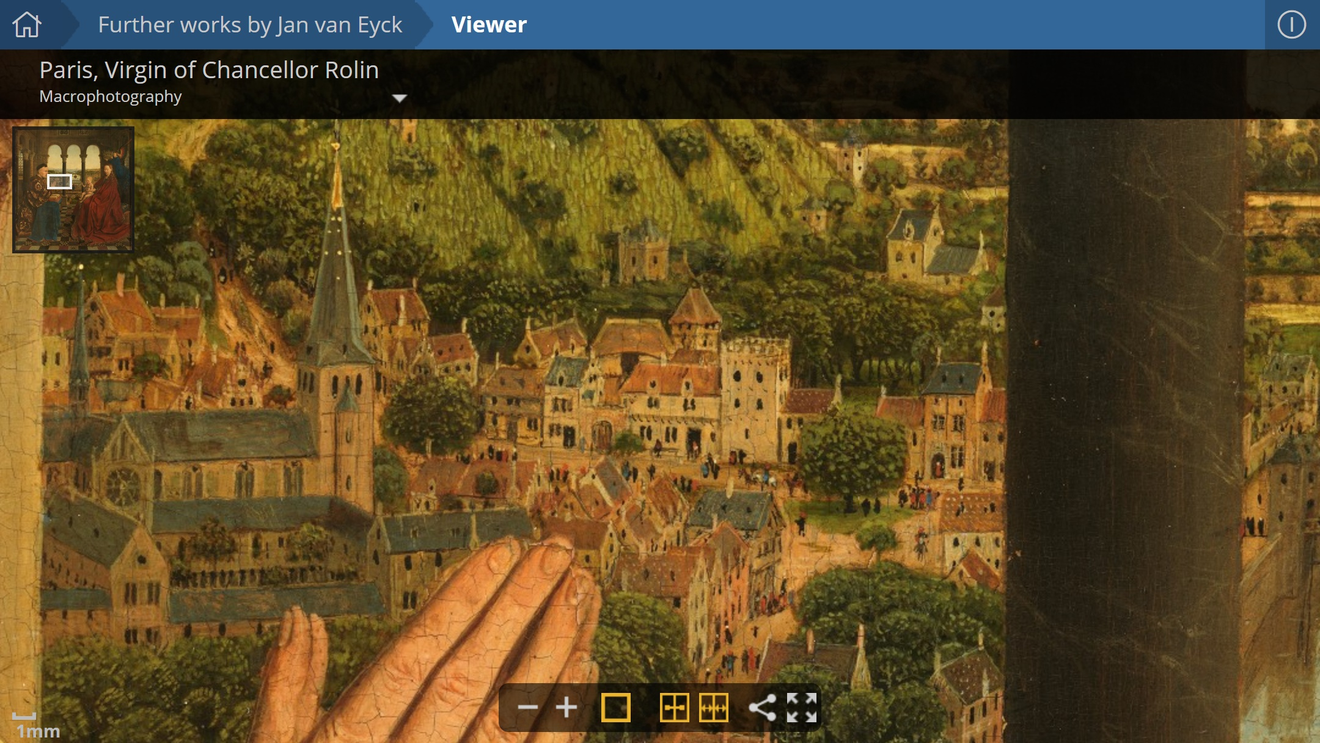

Slide 15
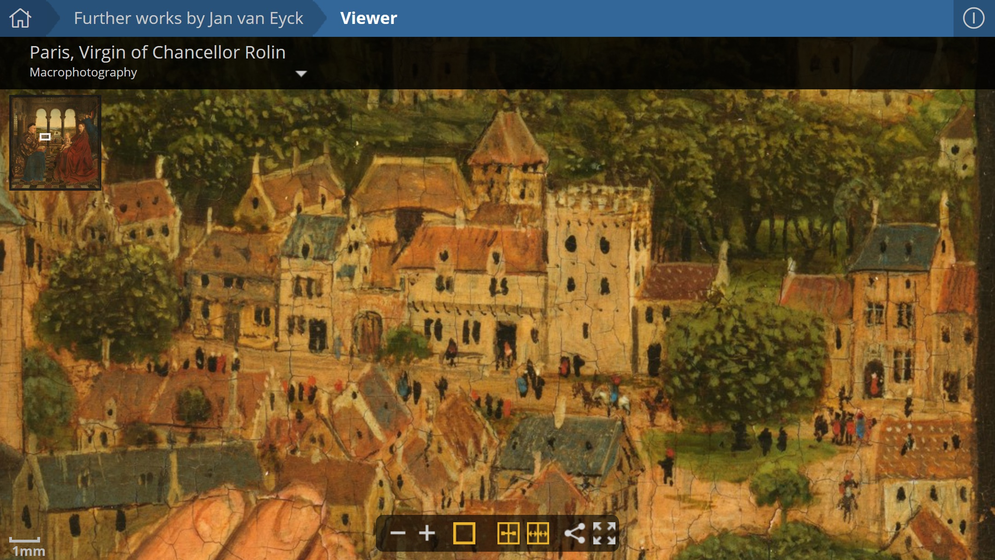

Slide 16
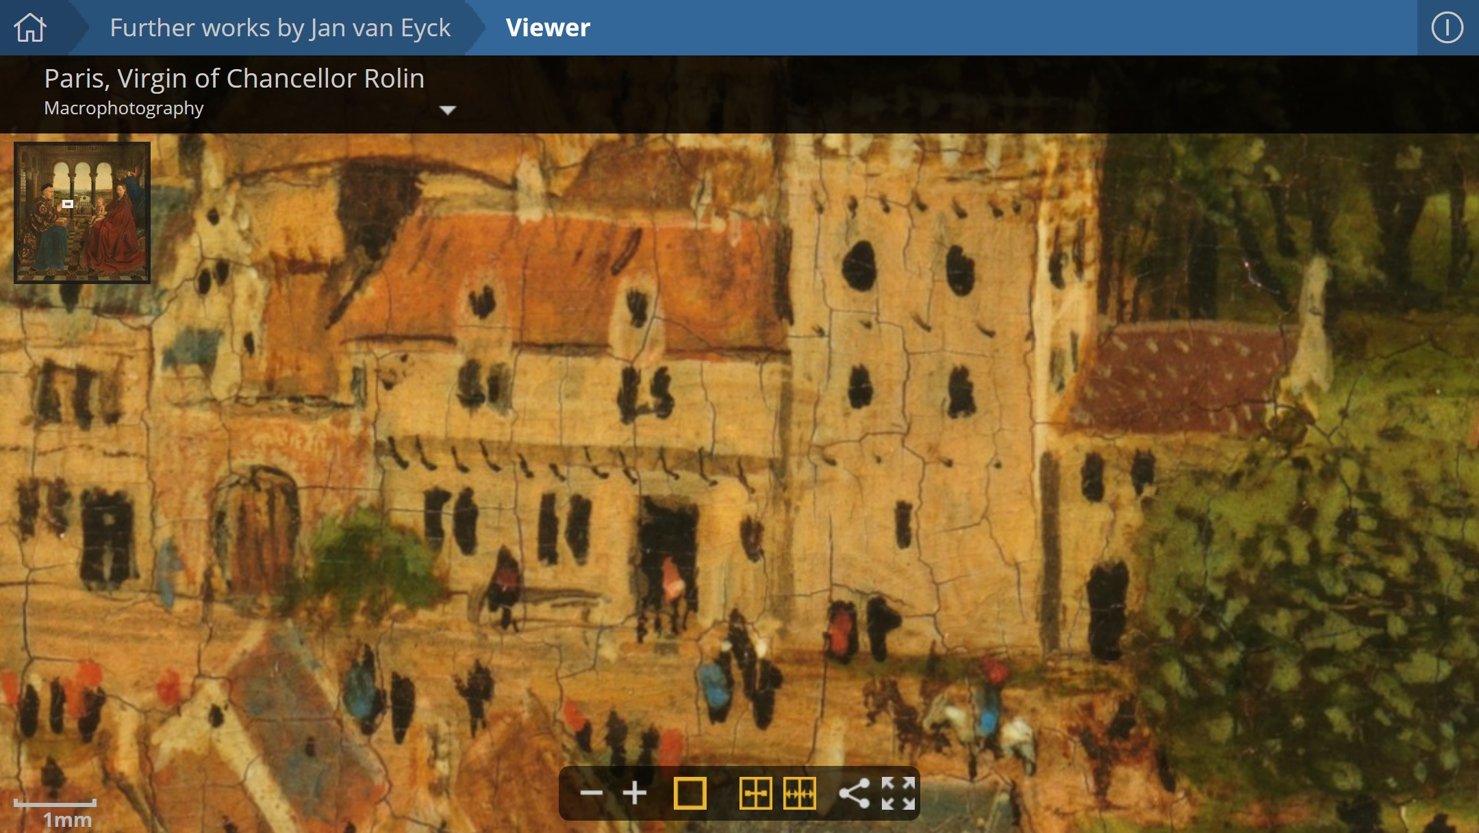

Slide 17
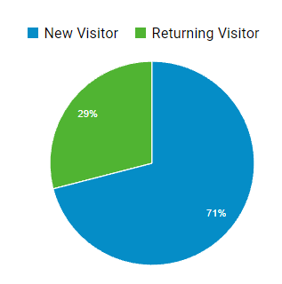
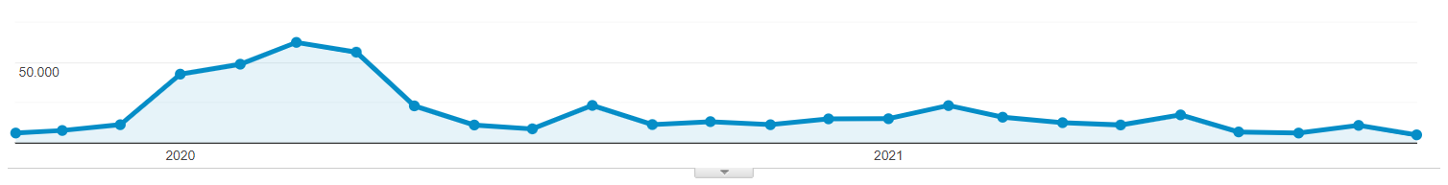
Analytics
Average of 13,000 unique visitors a month
70% new visitors and 30% returning visitors
Peak during Covid lockdown 60,000 in March 2002

Slide 18

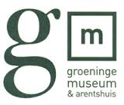

Partners:

Slide 19
Impact of Social Sciences, Humanities and Arts
13-15 October, 2021
Thank you!
#SSHA21

